Slide 1
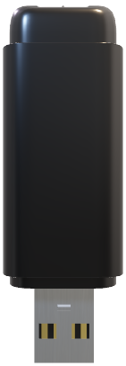
Storia

Slide 2
Storia

Slide 3
Storia
Table of contents
Technologies
The Task
Implementation

Slide 4
Storia
The Task
Technologies
Our goal is to create an application that features a login system, allowing users to add historical events to a timeline by entering years, rulers, and other details.
Additional functionalities include the ability to compare two historical events, as well as access to pre-provided materials about the most important periods in Bulgarian history.

Slide 5
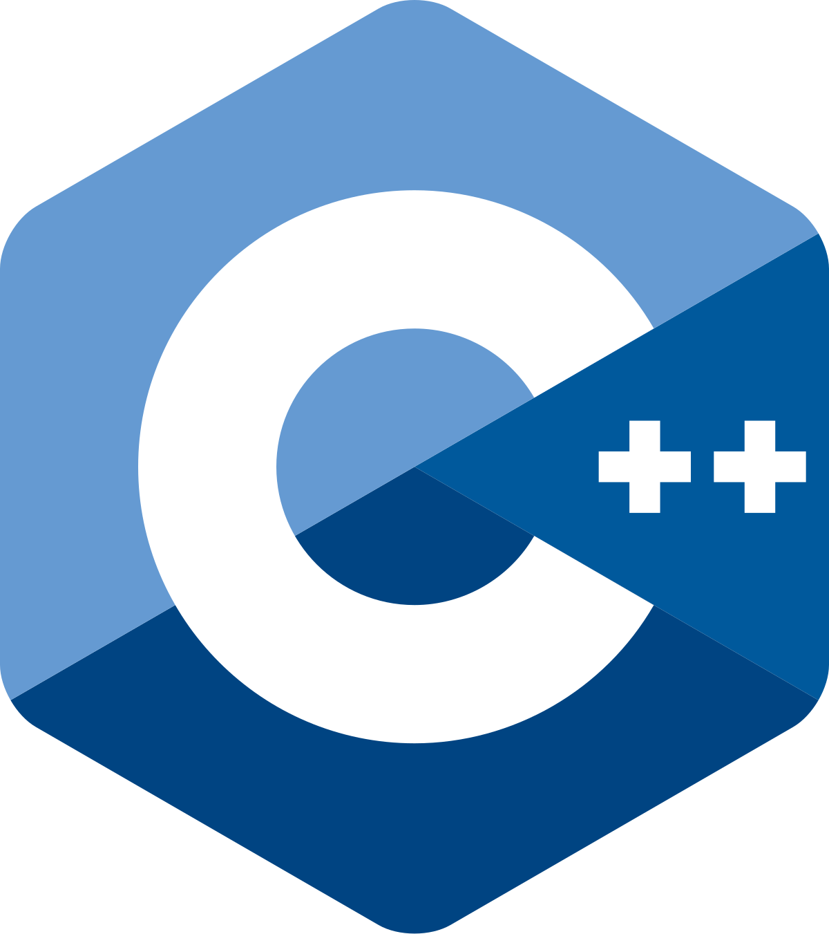









Storia
The Task
Technologies
Implementation

Slide 6
Storia
Technologies
Implementation
We embraced the challenge of creating a platform that brings history to life, showing dedication and creativity every step of the way in command prompt. Our mission is to make history more accessible and engaging by allowing users to build timelines, compare key events, and explore curated materials. Through an interactive experience, we aim to foster a deeper connection with the past, turning learning into an intuitive and meaningful journey.

Slide 7
Storia
Technologies
Let’s take a look

